Slide 1





HOME CREDIT LOAN RISK Group 5
Athulya Anand Shubham Patil Sricharraan Ramaswamy Varsha R
2000923101 2000938033 2000855651 2000751388
athanand@iu.edu shupatil@iu.edu sriramas@iu.edu varavi@iu.edu

Slide 2
Project description
The Home Credit International extracts and uses a variety of different data and modeling approaches in order to predict their clients' repayment capacity, which is their primary goal.
In this phase of our project, we majorly focus on performing an in-depth study of the HCDR data to make the necessary predictions.
As a part of this phase, we shall perform Exploratory Data Analysis, Machine Learning and statistical methods to determine the predictions that we make.
The Phase 1 predominantly involves the following steps:
Data extraction and preprocessing
Feature Engineering
Exploratory Data Analysis
Visual Exploratory Data Analysis
Baseline Pipeline
Logistic Regression
Random Forest Classifier
Naïve Bayes
Model prediction and accuracy check

Slide 3
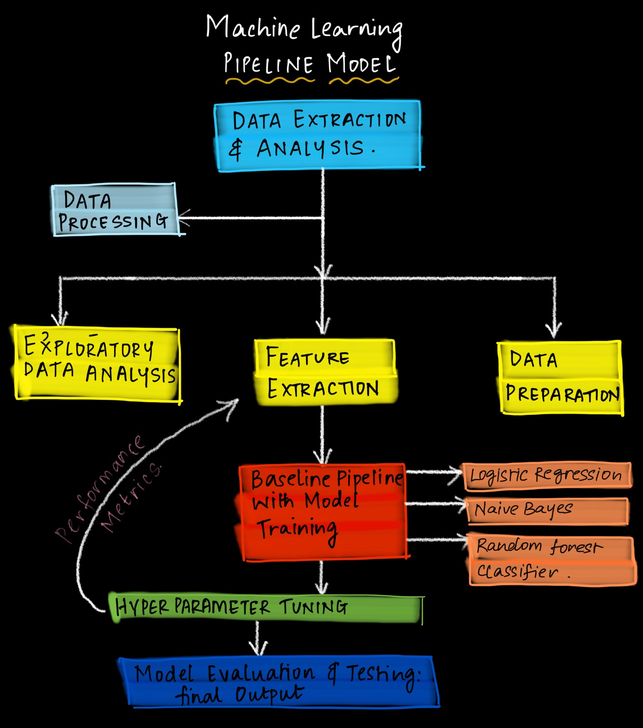
Overall Workflow

Slide 4
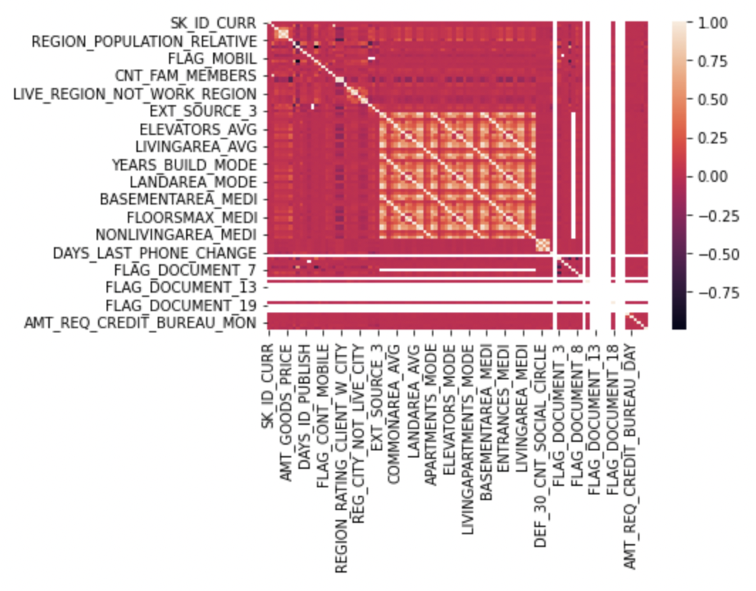
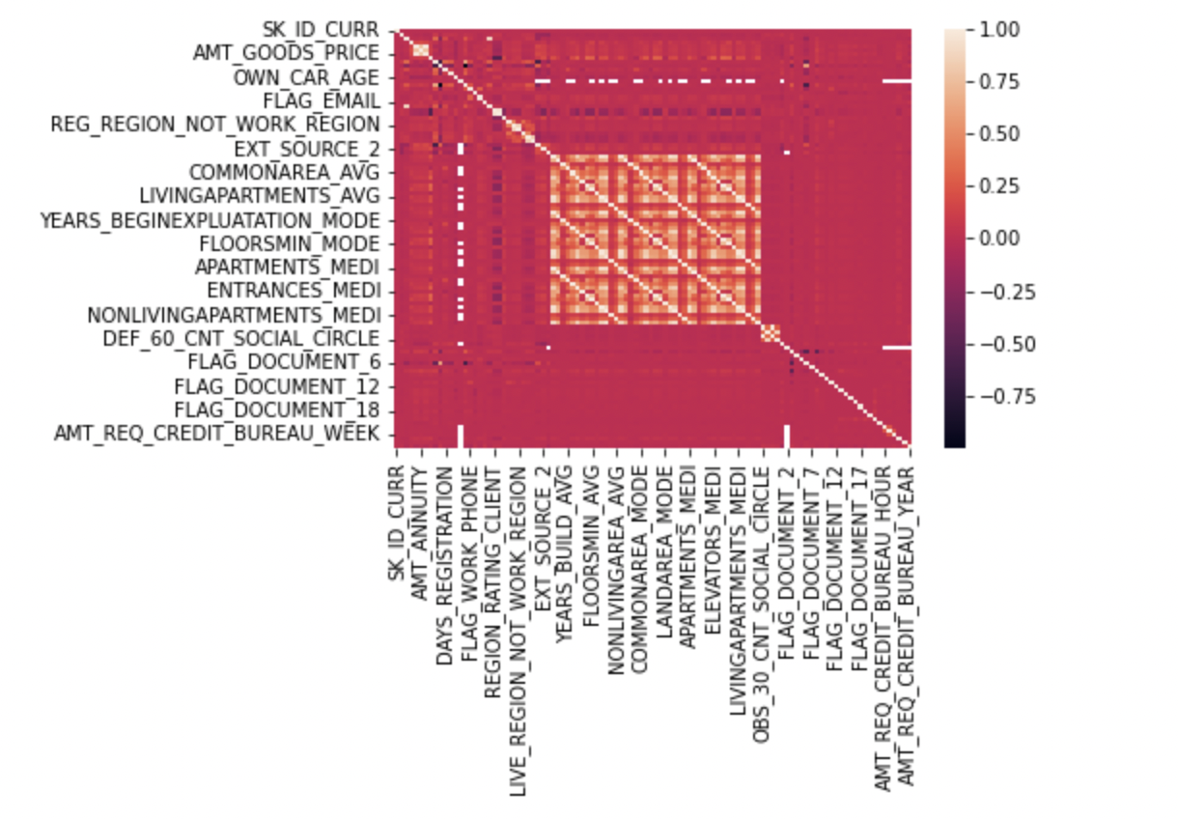
Correlation heatmaps
Fig 1: Correlation on Application_test dataset
Fig 2: Correlation on Application_train dataset

Slide 5
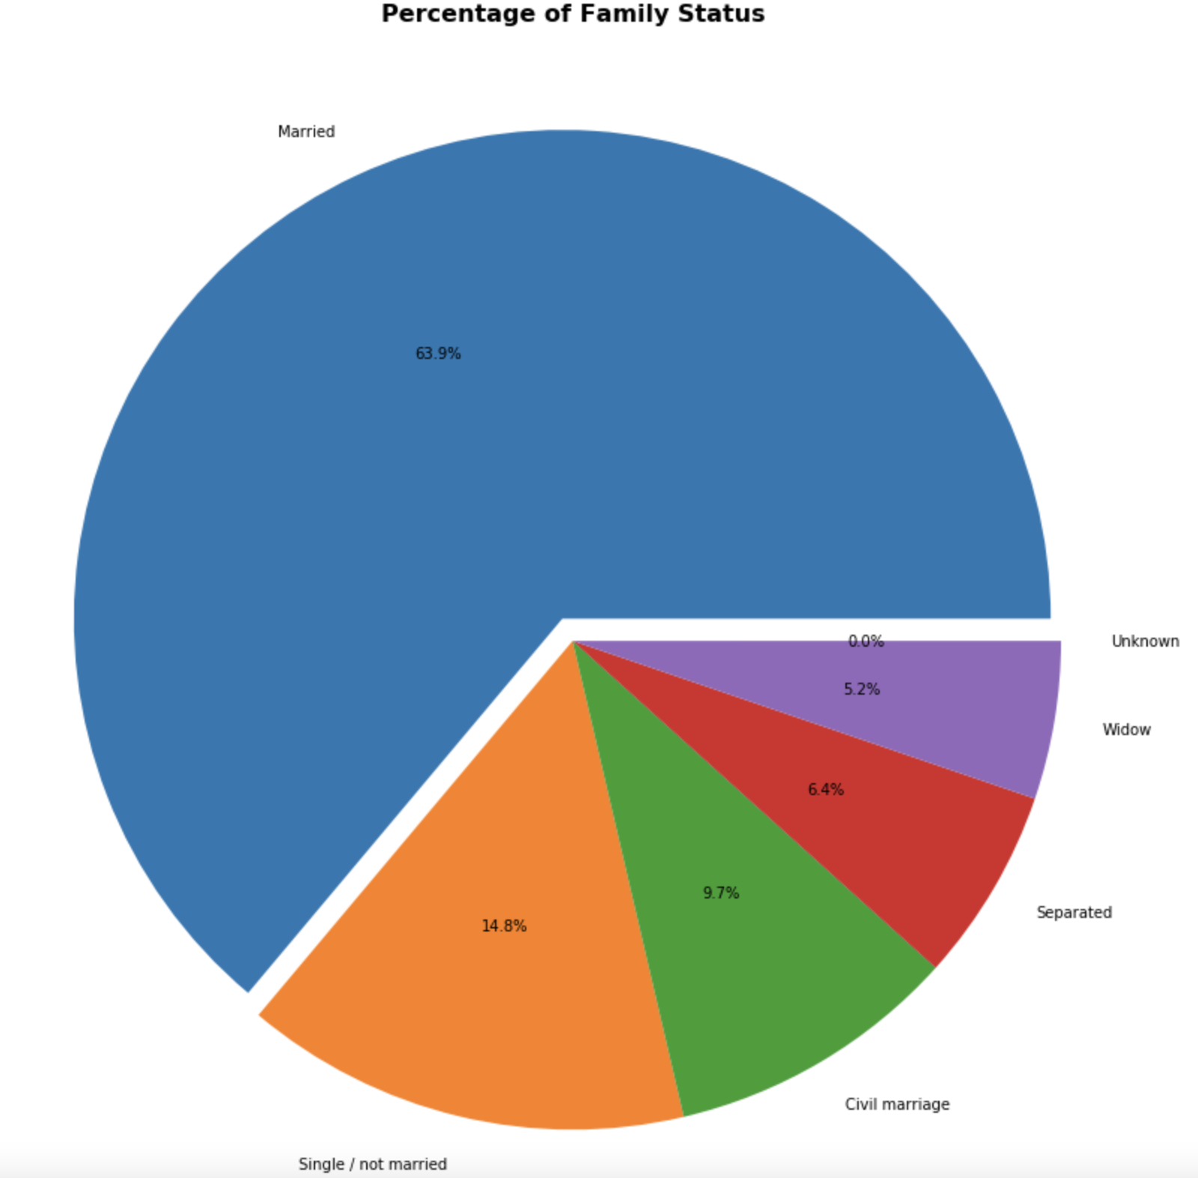
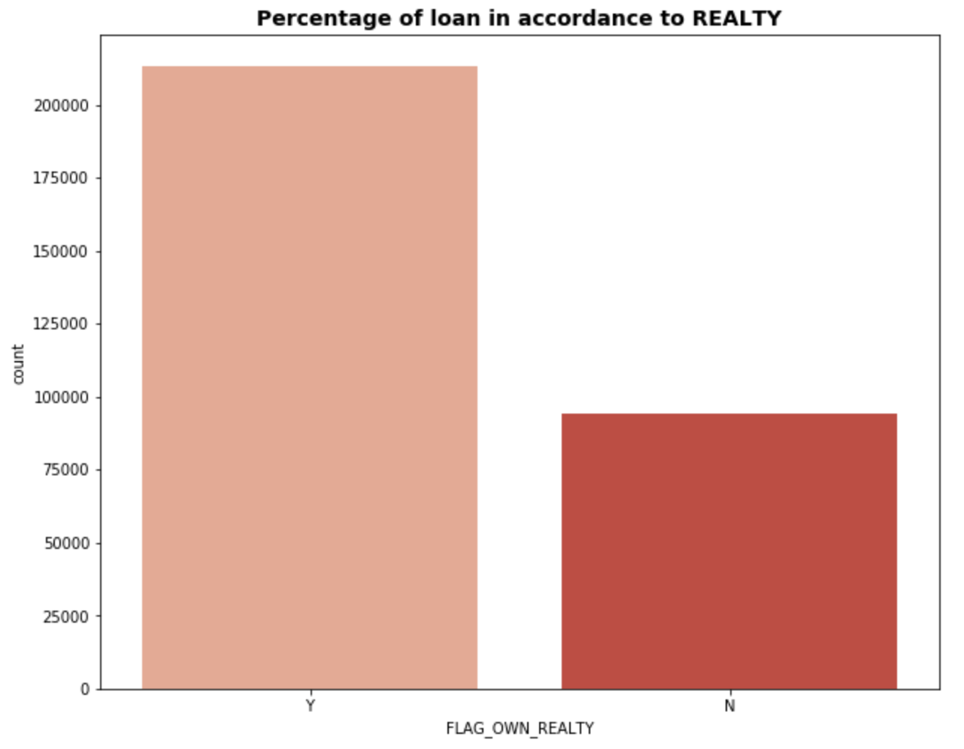
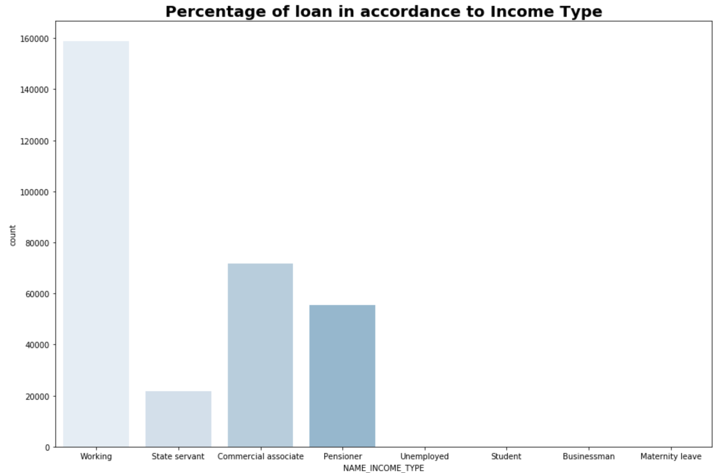
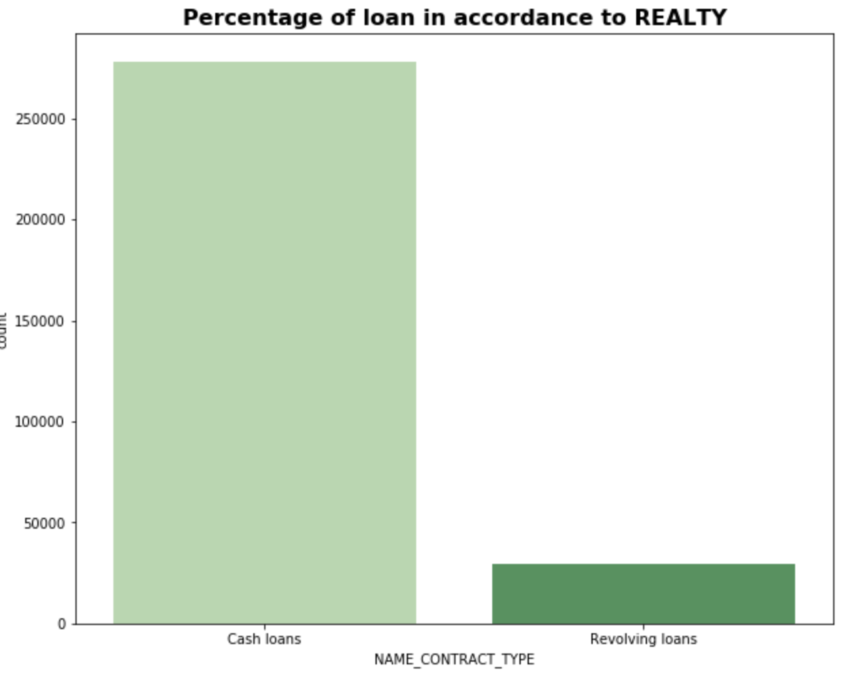
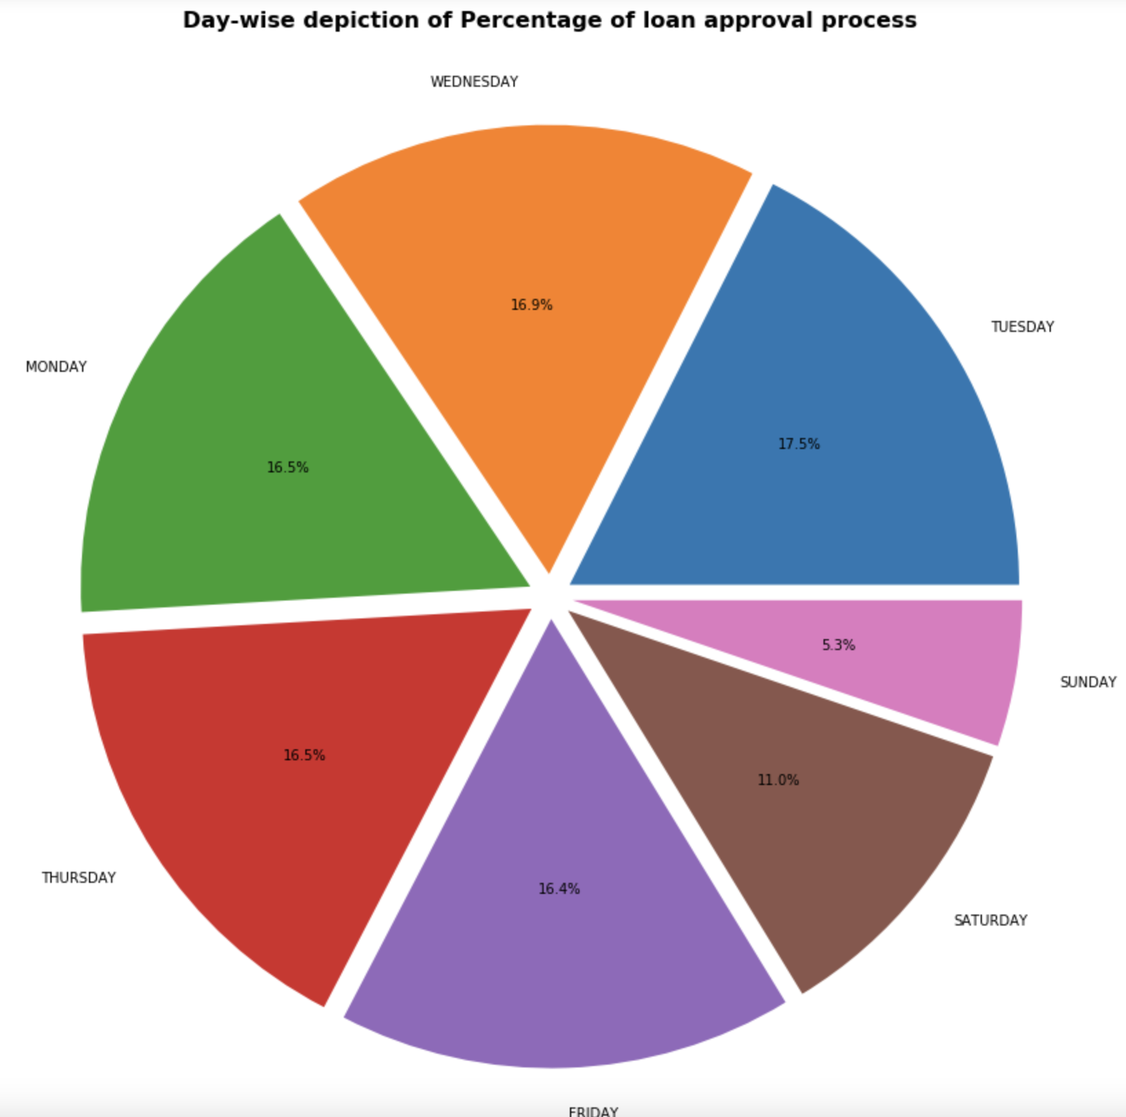
Visual exploratory data analysis
Categorical data

Slide 6
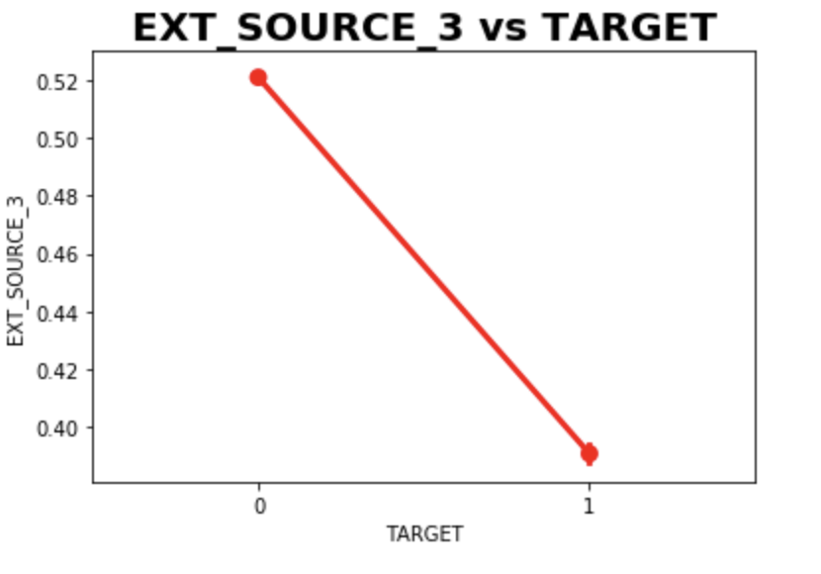
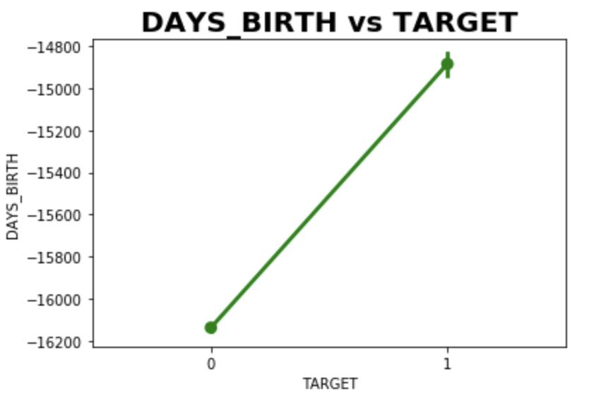
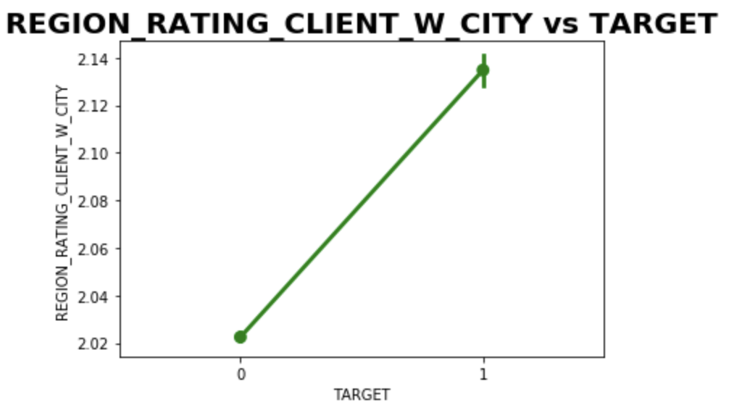
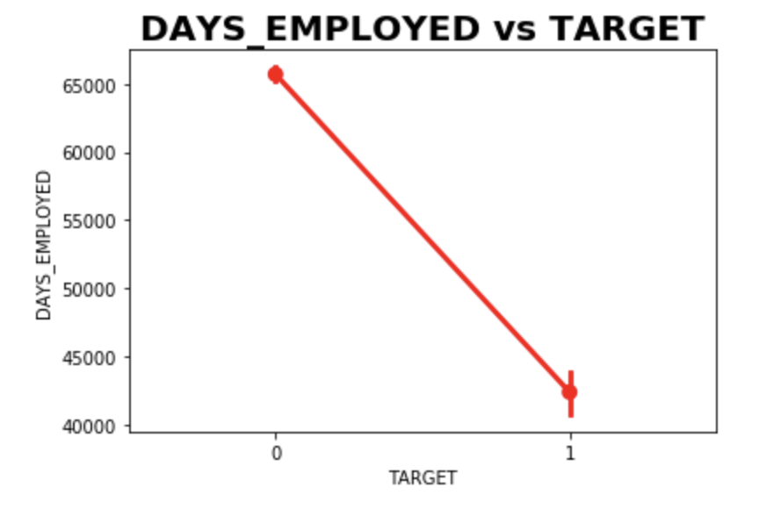
Visual exploratory data analysis
Numerical data

Slide 7
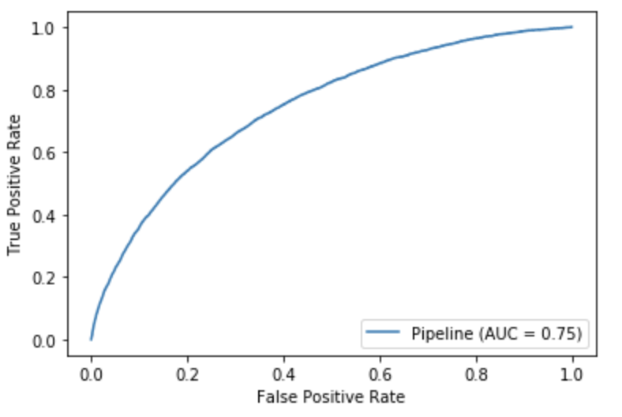
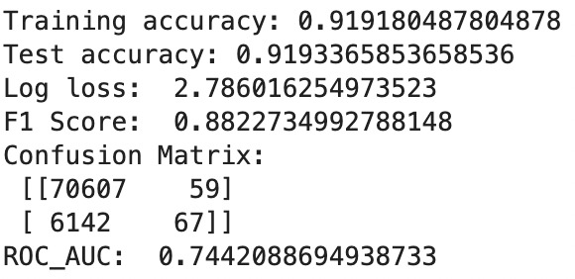
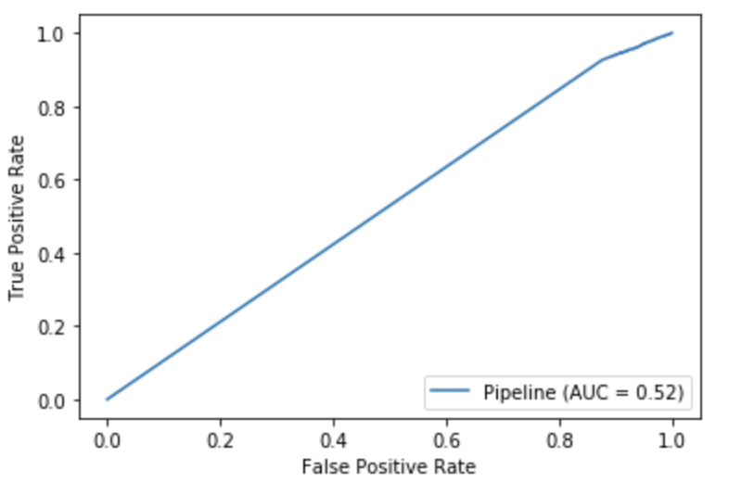
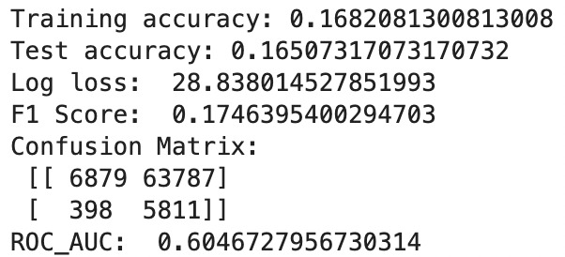
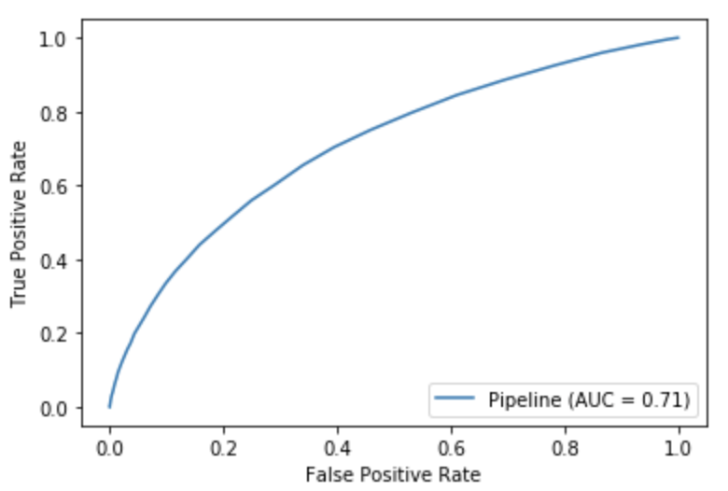
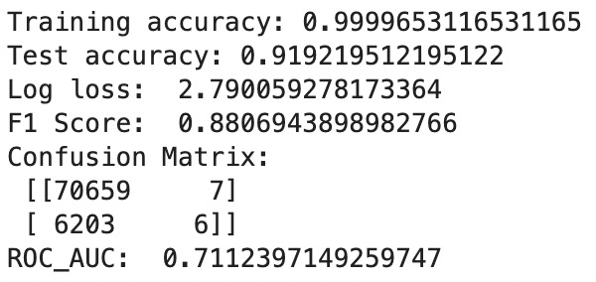
Logistic Regression
Baseline Pipeline
Naïve Bayes
Collected a set of final columns after considering the thresholds for dropping non-significant columns.
Created imputer pipelines to deal with the numerical and Categorical data separately.
Created the data pipeline which deals with the numerical and categorical data.
Once the data is fixed, we create a baseline pipeline which normalizes the data and feeds the data to Model.
Random Forest Classifier

Slide 8
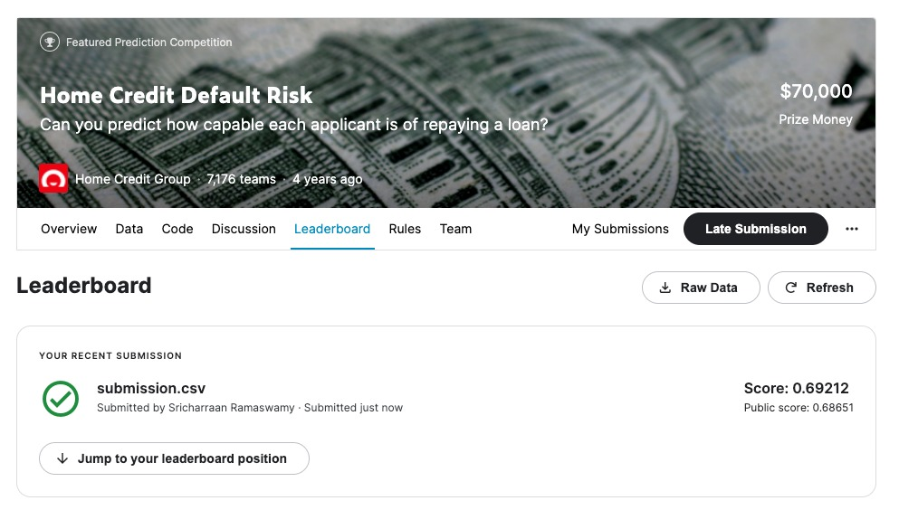
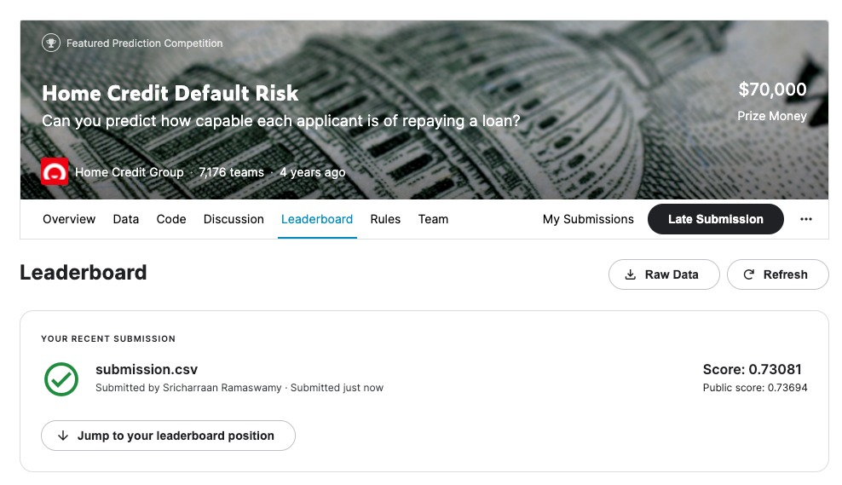
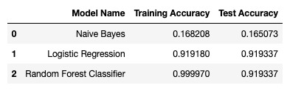
Model Prediction and accuracy check

Slide 9
Past, present, proposed, problems
PAST:
Selection of basic pipeline models and performance metrics.
PRESENT:
Data Extraction and Preprocessing, Feature Engineering, Exploratory Data Analysis, Visual Exploratory Data Analysis
PROPOSED:
We also intend to improve feature engineering, undertake hyperparameter tweaking for our models, and apply K-Fold cross validation and GridSearchCV, as well as some advanced gradient boosting models, in order to achieve the highest possible accuracy. Following this, we want to use Deep Learning approaches such as the development of Artificial Neural Networks to improve prediction results.
PROBLEMS:
Size of data and time constraints

Slide 10
Conclusion & next steps
Phase 1 involved the analysis and study of our dataset.
We cleaned the data and selected only the features that were relevant to the prediction and target variable.
We highlighted data that was performing OHE and used imputing methods to clean it up before feeding it to the model.
We were able to build a baseline process and grasp the accuracies of models like logistic regression, naïve bayes, and Random forest through experimentation.
On the train dataset, we found underfitting in naive bayes and overfitting in Random Forest based on the results of the models.
The best model that we could get for Phase 1 was Logistic Regression which gave a training accuracy of 91.9 % and the Kaggle submission accuracy of 73.08%.

